Slide 1

Interpolation
Chapter 18

Slide 2
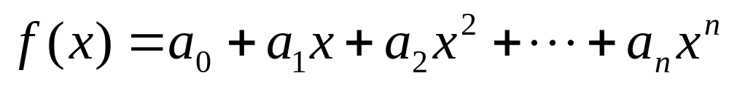
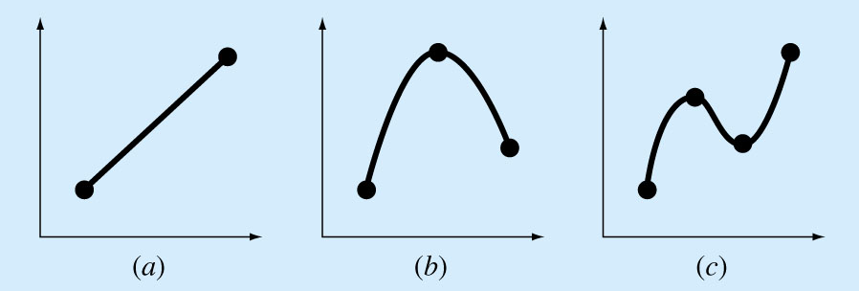
Interpolation : Estimation of a function value at an intermediate point
that lie between precise data points.
There is one and only one n^{th}-order polynomial that perfectly fits n+1 data points:
There are several methods to find the fitting polynomial:
  the Newton polynomial and the Lagrange polynomial

Slide 3
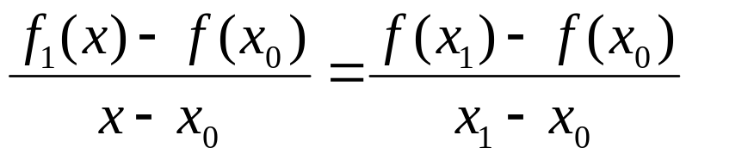
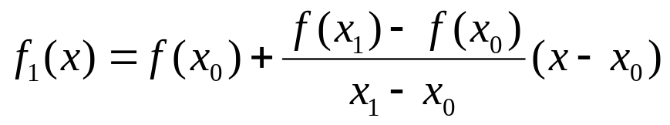
Newton’s Divided-Difference Interpolating Polynomials
Linear Interpolation
Connecting two data points with a straight line
f₁(x) designates a first-order interpolating polynomial.
Linear-interpolation formula
Slope

Slide 4
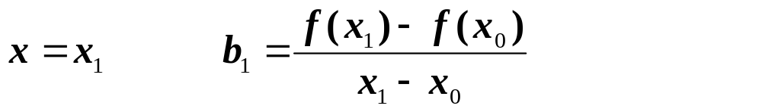
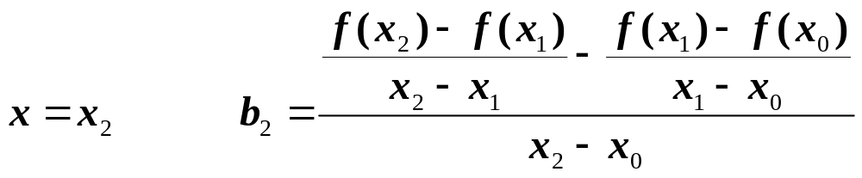
Quadratic Interpolation
If three (3) data points are available, the estimate is improved by introducing some curvature into the line connecting the points.
A second-order polynomial (parabola) can be used for this purpose
A simple procedure can be used to determine the values of the coefficients
Represents a second order polynomial
Could you figure out how to derive this using the above equation?

Slide 5
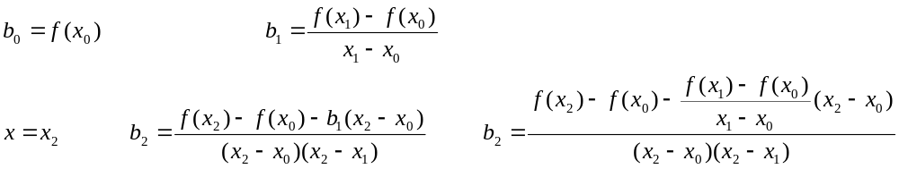
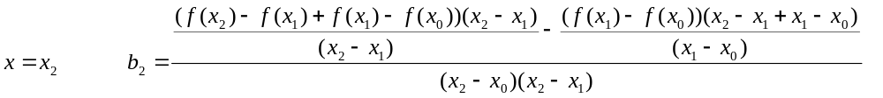
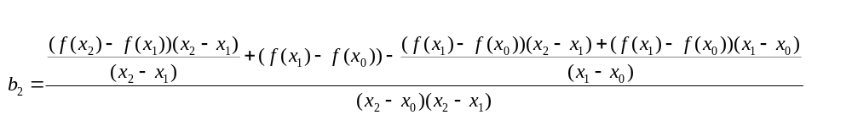
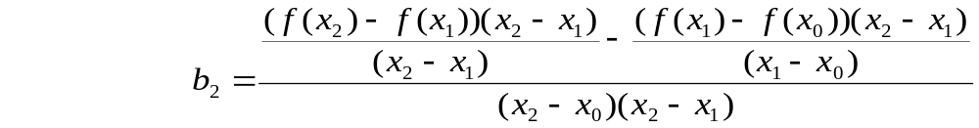


Slide 6
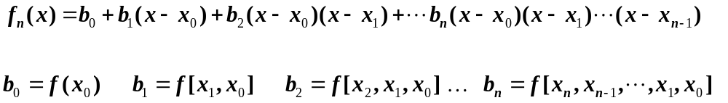
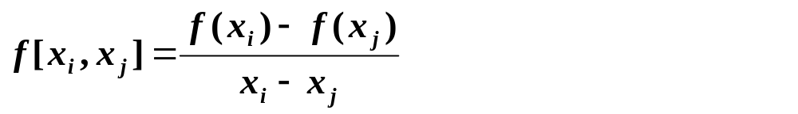
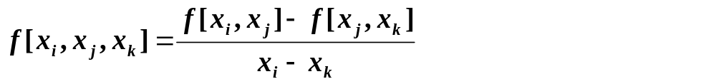
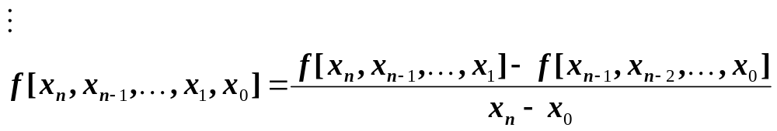
General Form of Newton’s Interpolating Polynomials
Bracketed function evaluations are finite divided differences

Slide 7
DIVIDED DIFFERENCE TABLE
EXAMPLE
x_{i} | f(x_{i})
x₀ | f(x₀)
x₁ | f(x₁)
x₂ | f(x₂)
x₃ | f(x₃)
x₄ | f(x₄)
f[x_{i},x_{j}]
f[x₁,x₀]
f[x₂,x₁]
f[x₃,x₂]
f[x₄,x₃]
f[x_{i},x_{j},x_{k}]
f[x₂,x₁,x₀]
f[x₃,x₂,x₁]
f[x₄,x₃,x₂]
f[x,x,x,x]
f[x₃,x₂,x₁,x₀]
f[x₄,x₃,x₂,x₁]
x_{i} | f(x_{i})
x₀=0 | 2
x₁=2 | 14
x₂=3 | 74
x₃=4 | 242
x₄=5 | 602
f[x_{i},x_{j}]
6
60
168
360
f[x_{i},x_{j},x_{k}]
18
54
96
f[x,x,x,x]
9
14
f[x...x]
1
f₁(x) = 2 + 6*(x-0) (based on x₀ and x₁)
f₂(x) = 2 + 6*(x-0)+18(x-0)(x-2) (based on x₀, x₁ and x₂)
f₃(x) = 2 + 6*(x-0)+18(x-0)(x-2)+9(x-0)(x-2)(x-3) (based on x₀, x₁, x₂, and x₃)
f₄(x) = 2 + 6x +18x(x-2) +9x(x-2)(x-3) +1x(x-2)(x-3)(x-4) (based on x₀, x₁, x₂, x₃, and x₄)
= x⁴ – x² + 2

Slide 8
Given:
x₀=1 f(x₀)=ln(1) = 0
x₁=e f(x₁)=ln(2.72) = 1
x₂=e² f(x₂)=ln(7.39) = 2
Estimate ln(2) = ?
using interpolation
Find f(x) first
x_{i} | f(x_{i})
x₀=1 | 0
x₁=2.72 | 1
x₂=7.39 | 2
f[x_{i},x_{j}]
.58
.214
f[x_{i},x_{j} x_{k}]
-.057
f(x) = 0.58(x-1)
-0.057(x-1)(x-2.72)
Then calculate
f(2)=0.58(2-1)-0.057(2-1)(2-2.72)
= 0.621
(* Approx. value for ln(2) *)
[ TRUE ln(2) = 0.6931 ]

Slide 9
Yet Another Example:
Given:
x₀=1 f(x₀)=ln(1)=0
x₁=4 f(x₁)=ln(4)=1.386
x₂=6 f(x₂)=ln(6)=1.791
Estimate ln(2) = ?
using interpolation
Find f(x) first
x_{i} | f(x_{i})
x₀=1 | 0
x₁=4 | 1.386
x₂=6 | 1.79
f[x_{i},x_{j}]
.462
.2025
f[x_{i},x_{j} x_{k}]
-.052
f(x) = 0.462(x-1)
-0.052(x-1)(x-4)
Then calculate
f(2)=0.462*(2-1) -0.052*(2-1)(2-4)
= 0.566
[ TRUE ln(2) = 0.693 ]

Slide 10
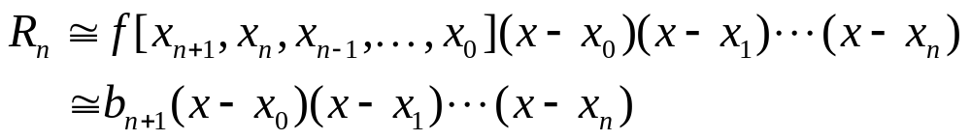
Error Estimation in Newton’s Interpolating Polynomials
Structure of interpolating polynomials is similar to the Taylor series expansion, i.e. finite divided differences are added sequentially to capture the higher order derivatives.
For an n^{th}-order interpolating polynomial, an analogous relationship for the error is:
If an additional point (x_{n+1} , f(x_{n+1})) is available, then
This result is based on the assumption that the series is strongly convergent. i.e. (n+1)^{th}-order prediction is closer to the true value than the n^{th}-order prediction.

Slide 11
Previous Example:
x₀=1 f(x₀)=ln(1) = 0
x₁=e f(x₁)=ln(2.72) = 1
x₂=e² f(x₂)=ln(7.39) = 2
f(x) = 0.58(x-1)
-0.057(x-1)(x-2.72)
f(2) = 0.621
Example (for computing error):
In the previous Example, add a fourth point
x₃=e^{0.5} = 1.6487 f(x₃) = 0.5
And estimate the approximate error in computing ln(2)
2nd order polynomial estimation: f(2) = 0.621
True error = ln(2) – f(2) = 0.693 - 0.621 = 0.072
Approximate Error:
R₂ = f₃(x) - f₂(x) = b₃ (x- x₀)(x- x₁)(x- x₂)
or
R₂= 0.0208*(x-1)(x-2.72)(x-7.39)
If we plug-in x=2 in the above expression, we get:
R₂= 0.0208*(2-1)(2-2.72)(2-7.39)= 0.0807
which is close to the true error (the same order of magnitude).

Slide 12
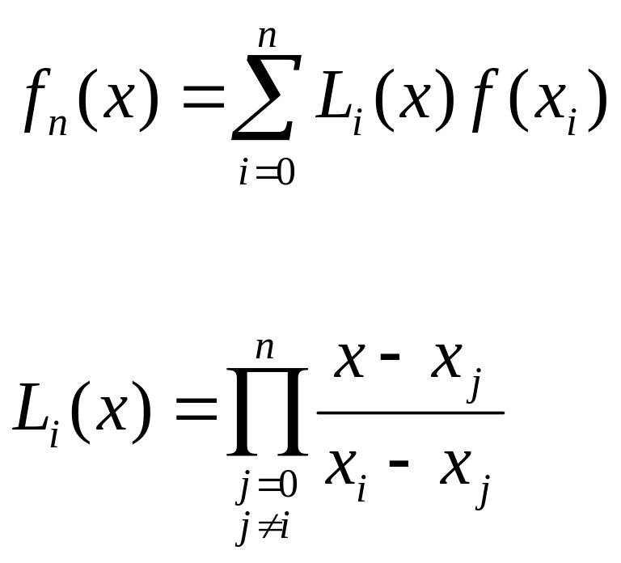
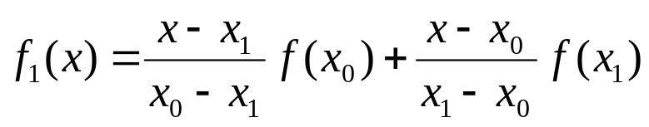
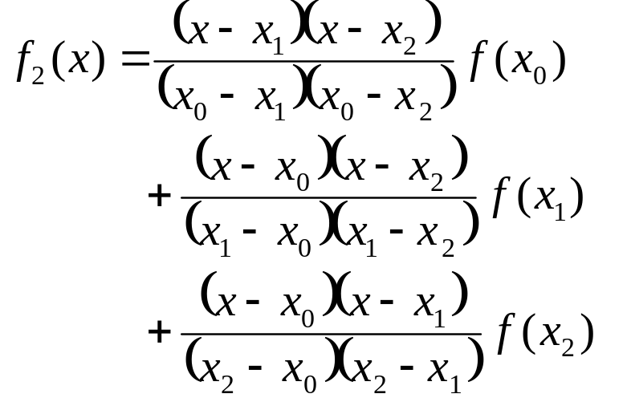
Lagrange Interpolating Polynomials
The Lagrange interpolating polynomial is simply a reformulation of the Newton’s polynomial that avoids the computation of divided differences:
Above formula can be easily verified by plugging in x₀, x₁…in the equation one at a time and checking if the equality is satisfied.

Slide 13
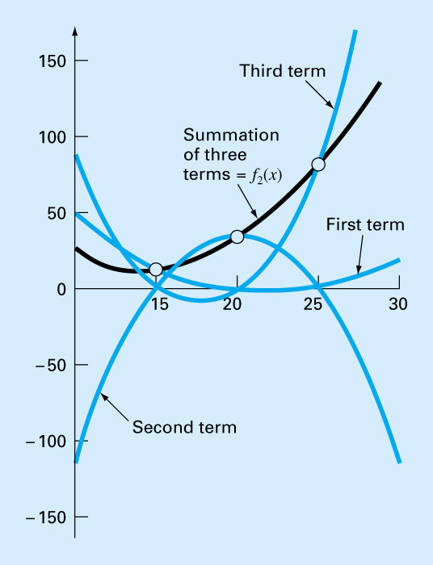
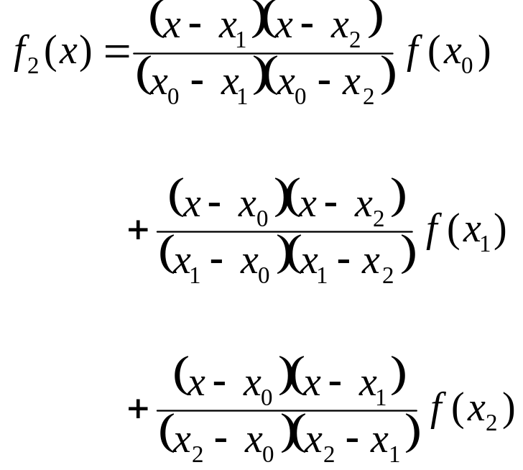
A visual depiction of the rationale behind the Lagrange polynomial . The figure shows a second order case:
Each of the three terms passes through one of the data points and zero at the other two. The summation of the three terms must, therefore, be unique second order polynomial f₂(x) that passes exactly through three points.

Slide 14
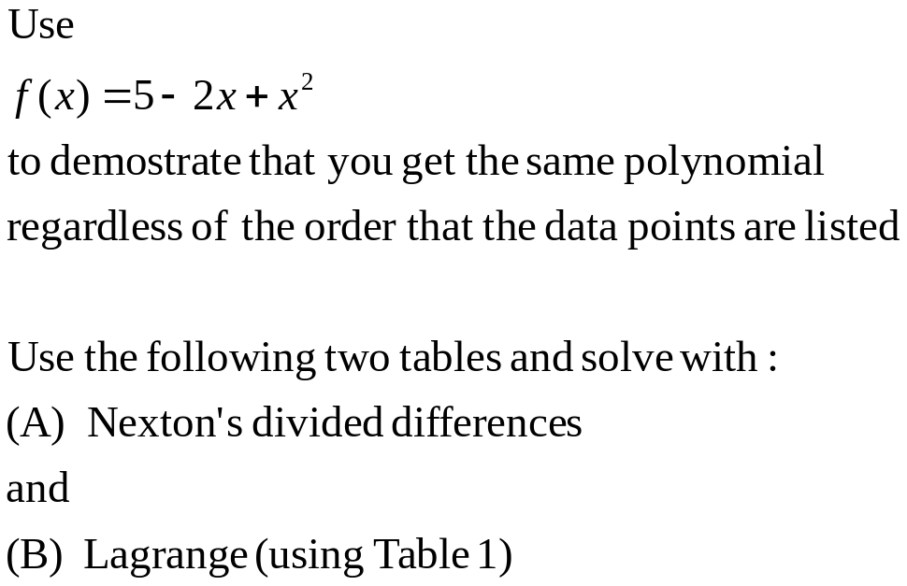
An example to demonstrate that ‘order does not matter’
x_{i} | f(x_{i})
x₀= 0 | 5
x₁= 1 | 4
x₂= 3 | 8
x_{i} | f(x_{i})
x₀= 3 | 8
x₁= 1 | 4
x₂= 0 | 5

Slide 15

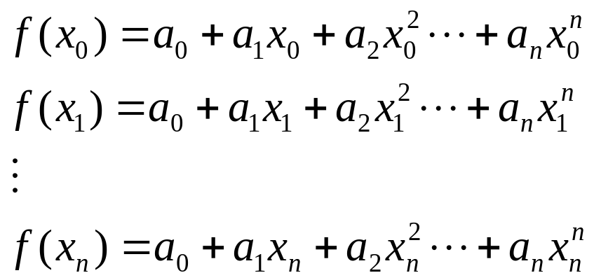
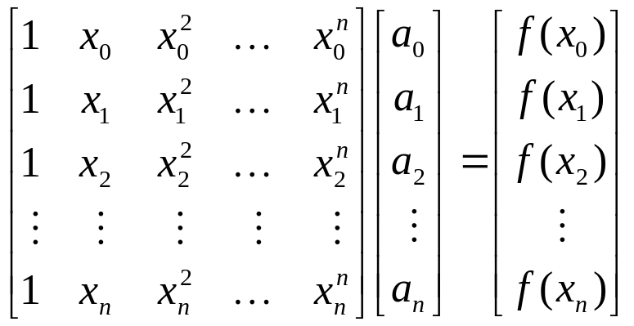
Coefficients of an Interpolating Polynomial
Although both the Newton and Lagrange polynomials are well suited for determining intermediate values between points, they do not provide a polynomial in conventional form:
Since n+1 data points are required to determine n+1 coefficients, simultaneous linear systems of equations can be used to calculate “a”s.
Where “x”s are the knowns and “a”s are the unknowns.
Time complexity for Newton’s: O(n²) vs. Gaussian Elim. O(n³)
Another reason: this approach results in a highly unstable (ill-conditioned) system of equations. Therefore, Newton or Lagrange interpolation is preferred.

Slide 16

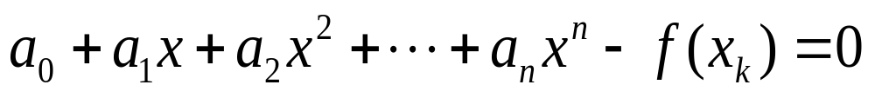
Inverse Interpolation
Given (x₀, f(x₀)), (x₁, f(x₁)), (x₂, f(x₂)), …, (x_{n}, f(x_{n}))
and a function value f(x_{k}), how do you determine (x_{k}) ?
Using one of the interpolation methods (Newton or Lagrange), obtain the function f(x) :
Plug in the value of f(x_{k}) in the above equation and find one of the real roots of the resultant equation using a root finding method:

Slide 17
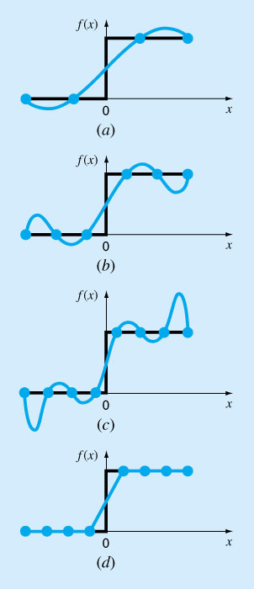
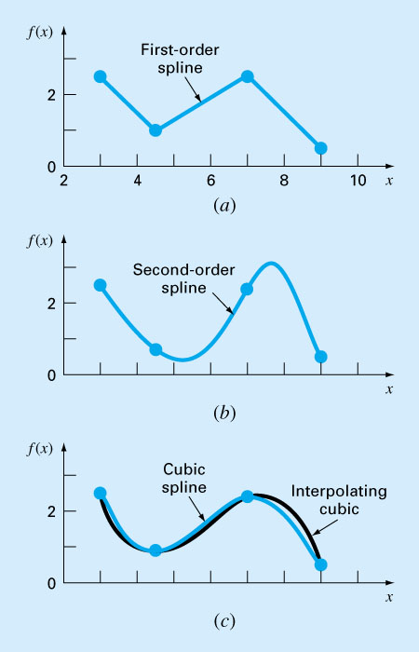
Spline Interpolation
There are cases where polynomials can lead to erroneous results because of round off error and overshoot.
Alternative approach is to apply lower-order polynomials to subsets of data points. Such connecting polynomials are called spline functions.
EXAMPLE:
spline fits for a set of 4 points:
(a) linear
(b) quadratic
(c) cubic splines
linear spline ➔ ➔➔
is superior to higher-order interpolating polynomials (parts a, b, and c)

Slide 18
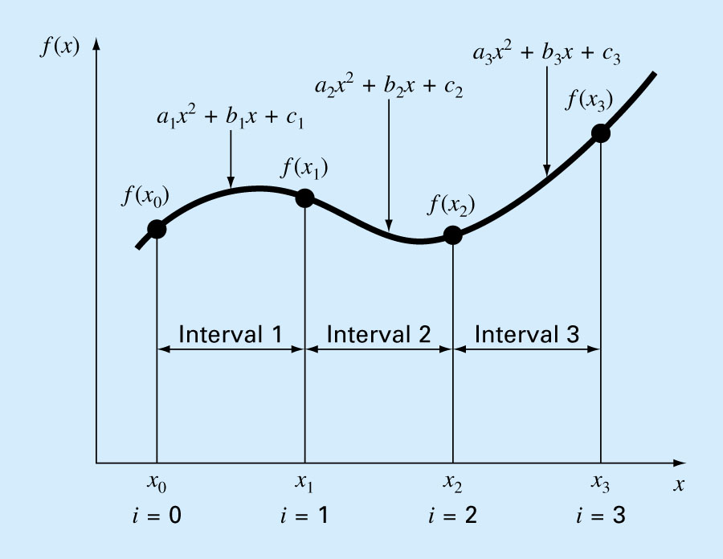
Quadratic Spline example

Slide 19
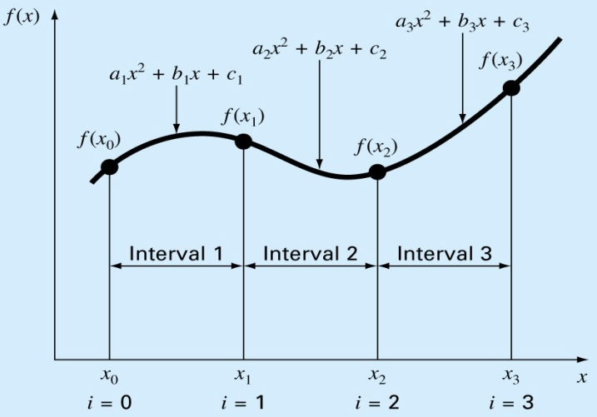
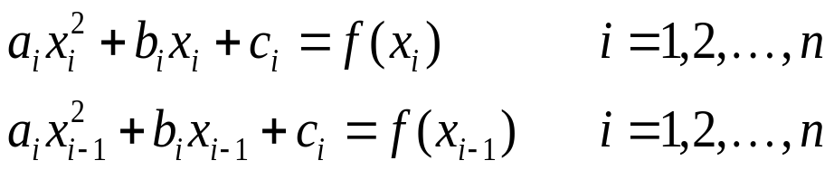
Quadratic Splines - Equations
Given (n+1) points, there are 3(n) coefficients to find and hence, need to determine 3n equations to solve:
Each polynomial must pass through the endpoints of the interval that they are associated with. And these
conditions result in 2n equations:
The first derivatives at the interior knots must be equal ((n-1) equations):
So far, we are one equation short. Since the last equation will be derived using only 2 points, it must be a line equation with only b_{n} and c_{n} to be determined (a_{n} = 0)

